Slide 1
Input data
01
Inserting data into the program

Slide 2
Main Menu
while(mainOn != false)
{
cout << endl;
cout << " Insert input" << endl ;
cout << " 1. Insert item" << endl ;
cout << " 2. Sell item" << endl ;
cout << " 3. Check item" << endl ;
cout << " 4. Print " << endl ;
cout << " 5. End program" << endl ;
cout << " Enter: " ;
cin >> choicemenu ;

Slide 3
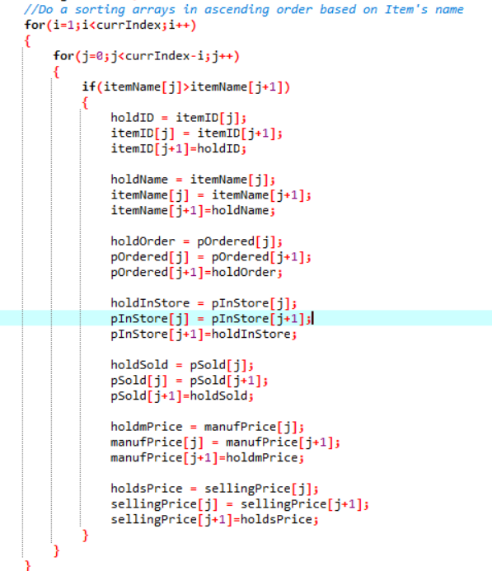
Sorting
Sort the arrays in ascending order
Pass by values
If j is less than currIndex, loop will repeat

Slide 4
Loop for new data
cout << "Add another item? yes[y] / no[n] >> ";
cin >> selectManualMenu;
{
switch(selectManualMenu.at(0))
{case 'y':
manualOn = true;
break;
case 'n':
manualOn = false;
break;
default:
cout << "ERROR 113: PLEASE TRY AGAIN" << endl << endl;
manualOn = false;

Slide 5
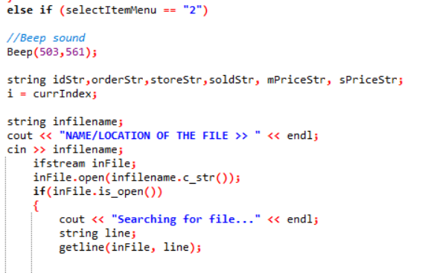
opening the file
Name/location
Beep
Using fstream
Beep sound when user input ‘2’

Slide 6
02
Sell
Explanation about altering the data

Slide 7
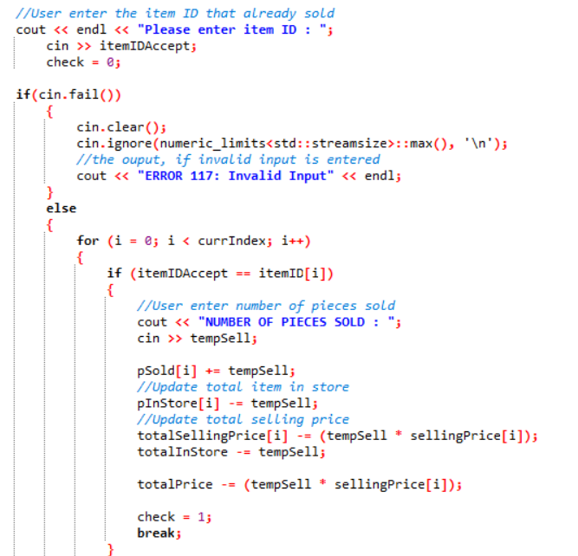
The Slide Title Goes Here!
Item can only be sell if the program has the data
itemIDaccept == itemID
User enter the number of quantity to sell
Update new value after sell

Slide 8
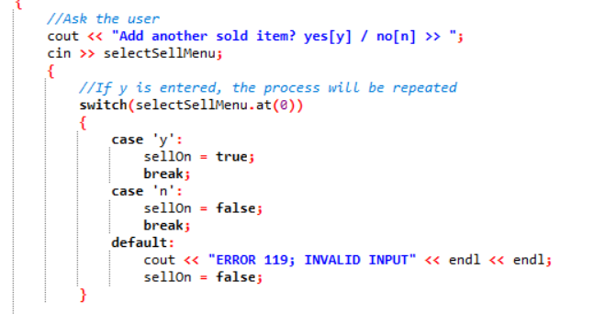
Re-input data
Yes [y]
Repeat process
No [n]
Sellon = false
Stop loop
Others
Display error

